Slide 1


Community based diagnosis of Parkinsonism as a medical university extension project
Kelson James Almeida (MD, Phd), Lucia Rego Medeiros (MD, Msc), Naldiana Cerqueira (MD, Phd), Marco Aurélio Alves
Presented by Prof. Kelson James
E-mail: kelsonj@ufpi.edu.br

Slide 2
Introduction
Parkinson's disease affects 1% of the world population over 55 years old or 0.3% of the general population
Its incidence and prevalence increase with age, with a peak incidence about the sixth decade of life
In Brazil, the Bambuí study (city of Minas Gerais) showed a prevalence of Parkinsonism of 7.2%
here is a lack in accessing early diagnosis of Parkinson's disease
(WHO, 2021)
(CAMPOS, 2010; MOREIRA, 2014)
(BARBOSA, 2006)

Slide 3
Aims and Methods
Aim:To describe a university extension project for support in diagnosing Parkinsonism in elderly individuals from communities
Method: A descriptive study

Slide 4
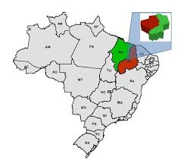
Results
All subjects from northeastern Brazilian region who seek by their own demand a neurological evaluation were included
We visited institutionalized elderly individuals

Slide 5
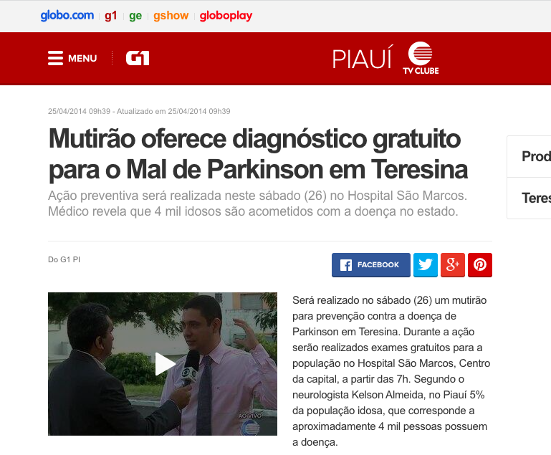
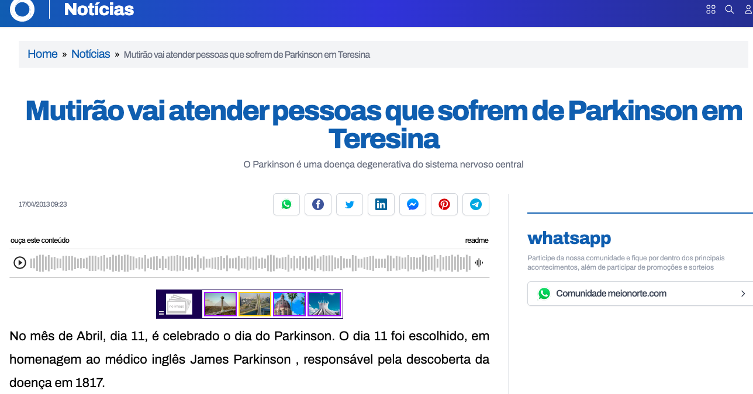
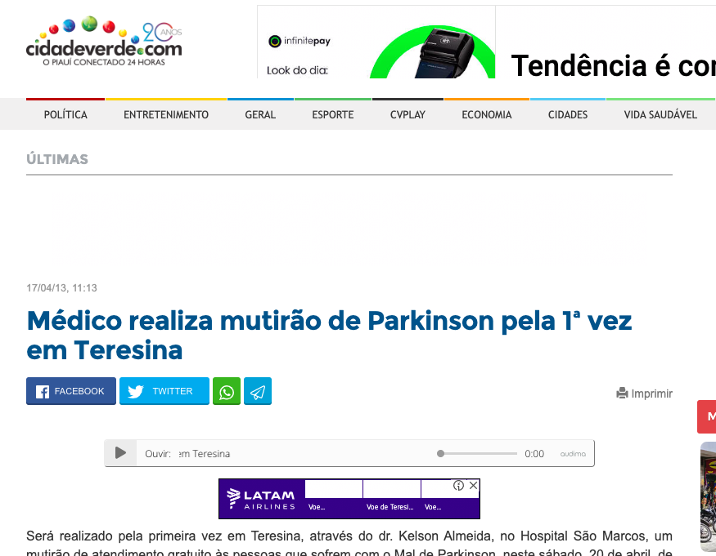
Results
3 Steps:
1 Step -
media alerts

Slide 6
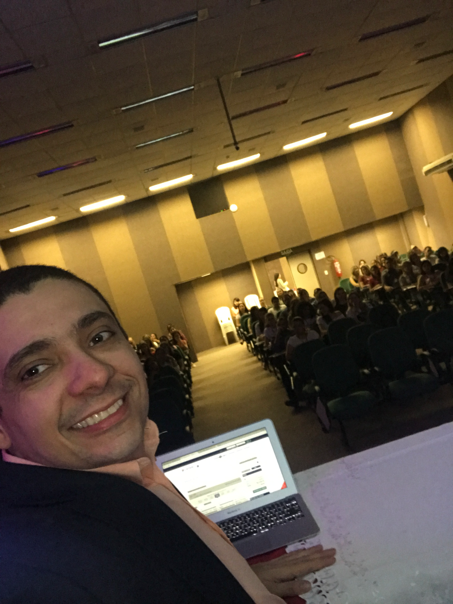
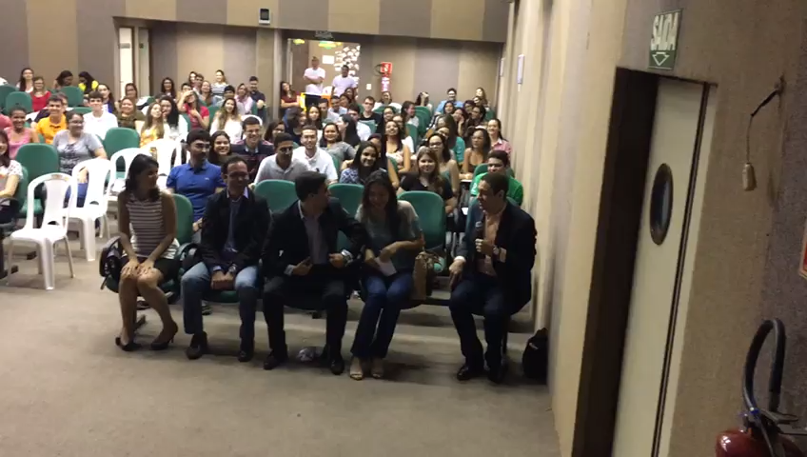
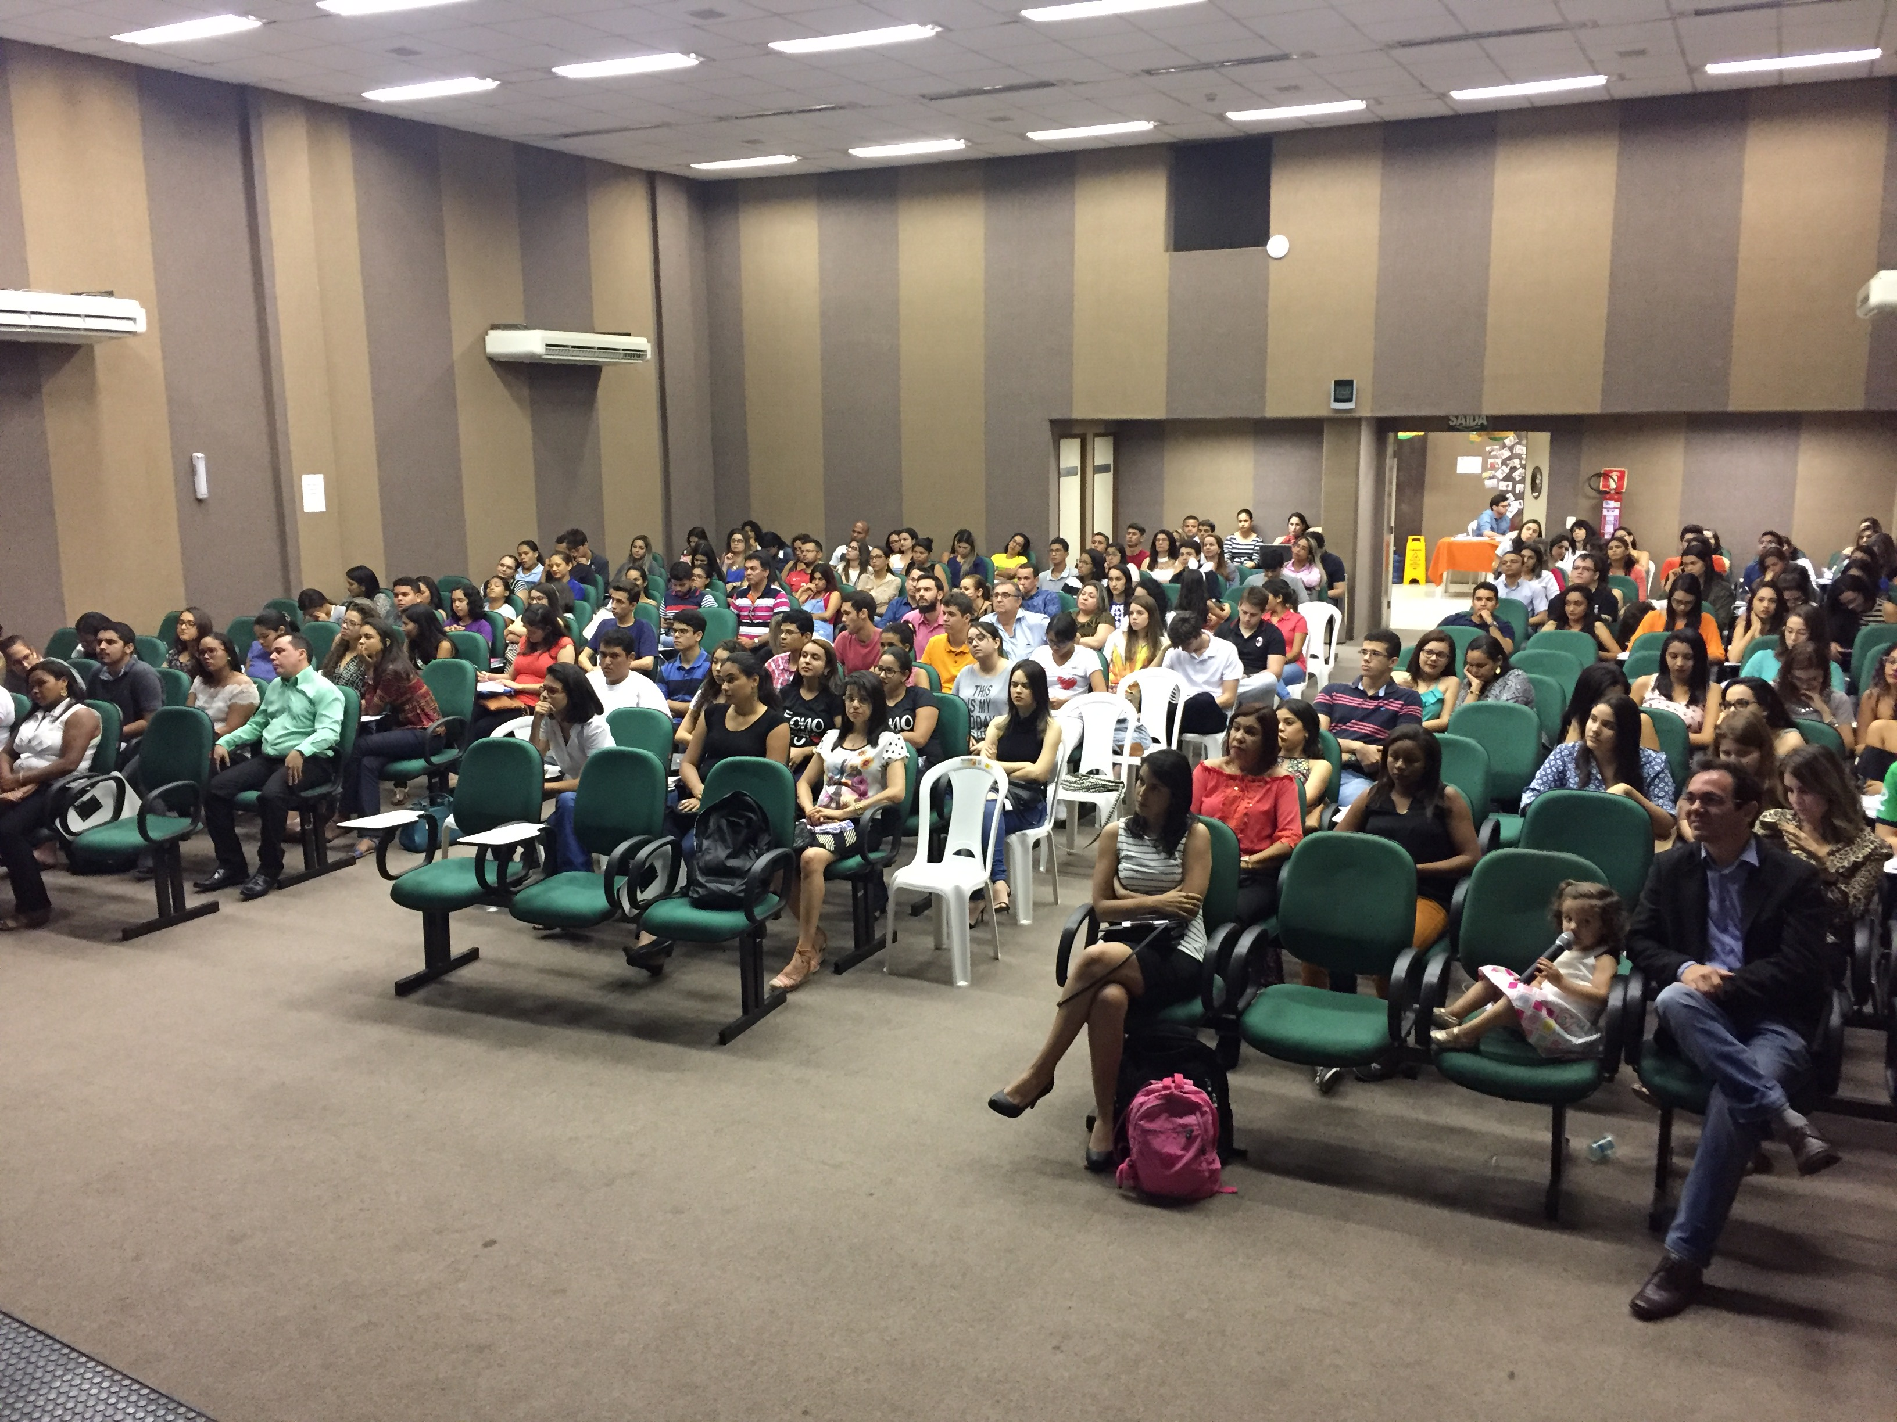
Results
3 Steps:
2 Step
medical students training

Slide 7
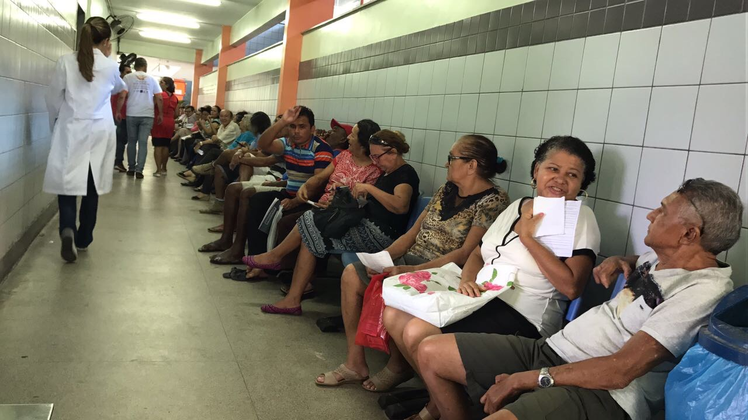
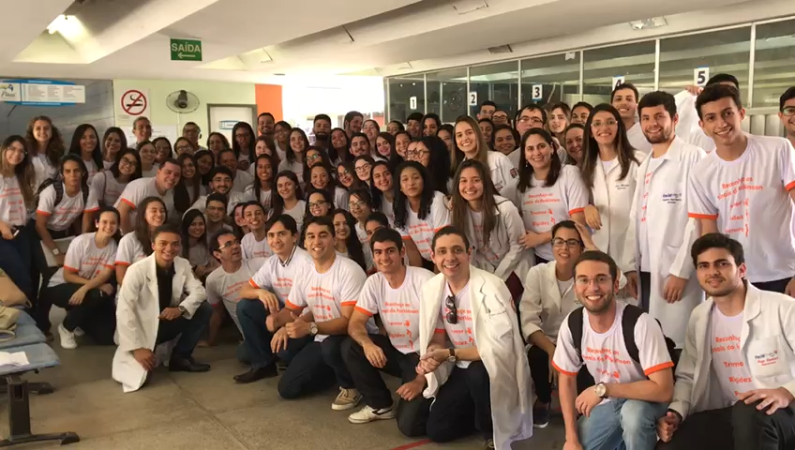
Results
3 Step
days of care - outpatient clinics
Multidisciplinary team composed of neurologists, physiotherapists, speech therapists, and occupational therapists

Slide 8
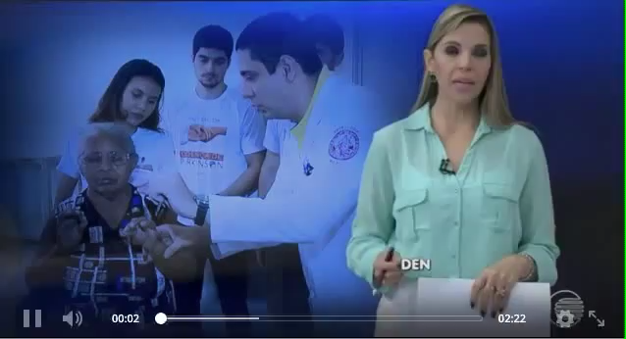
Results

Slide 9
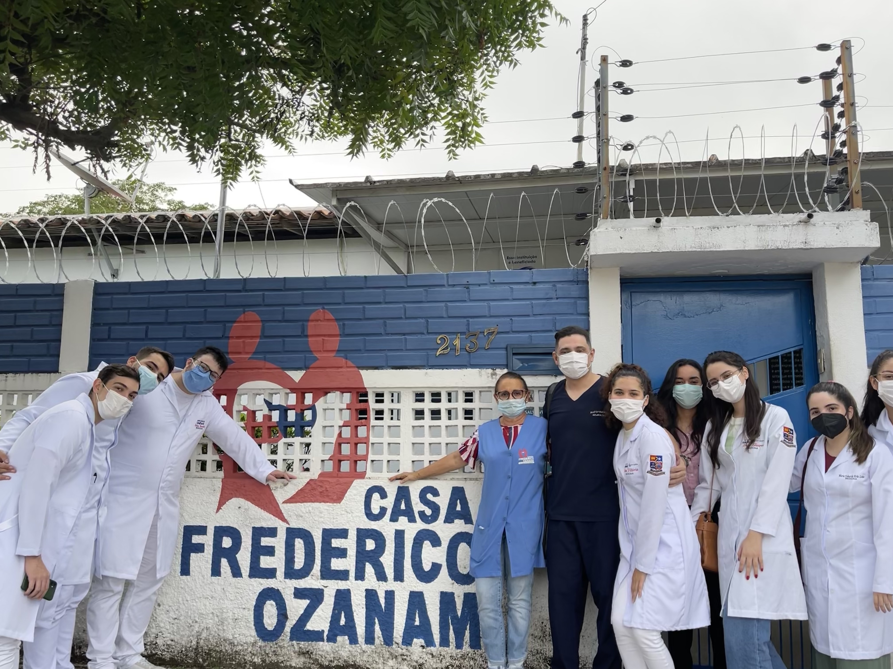
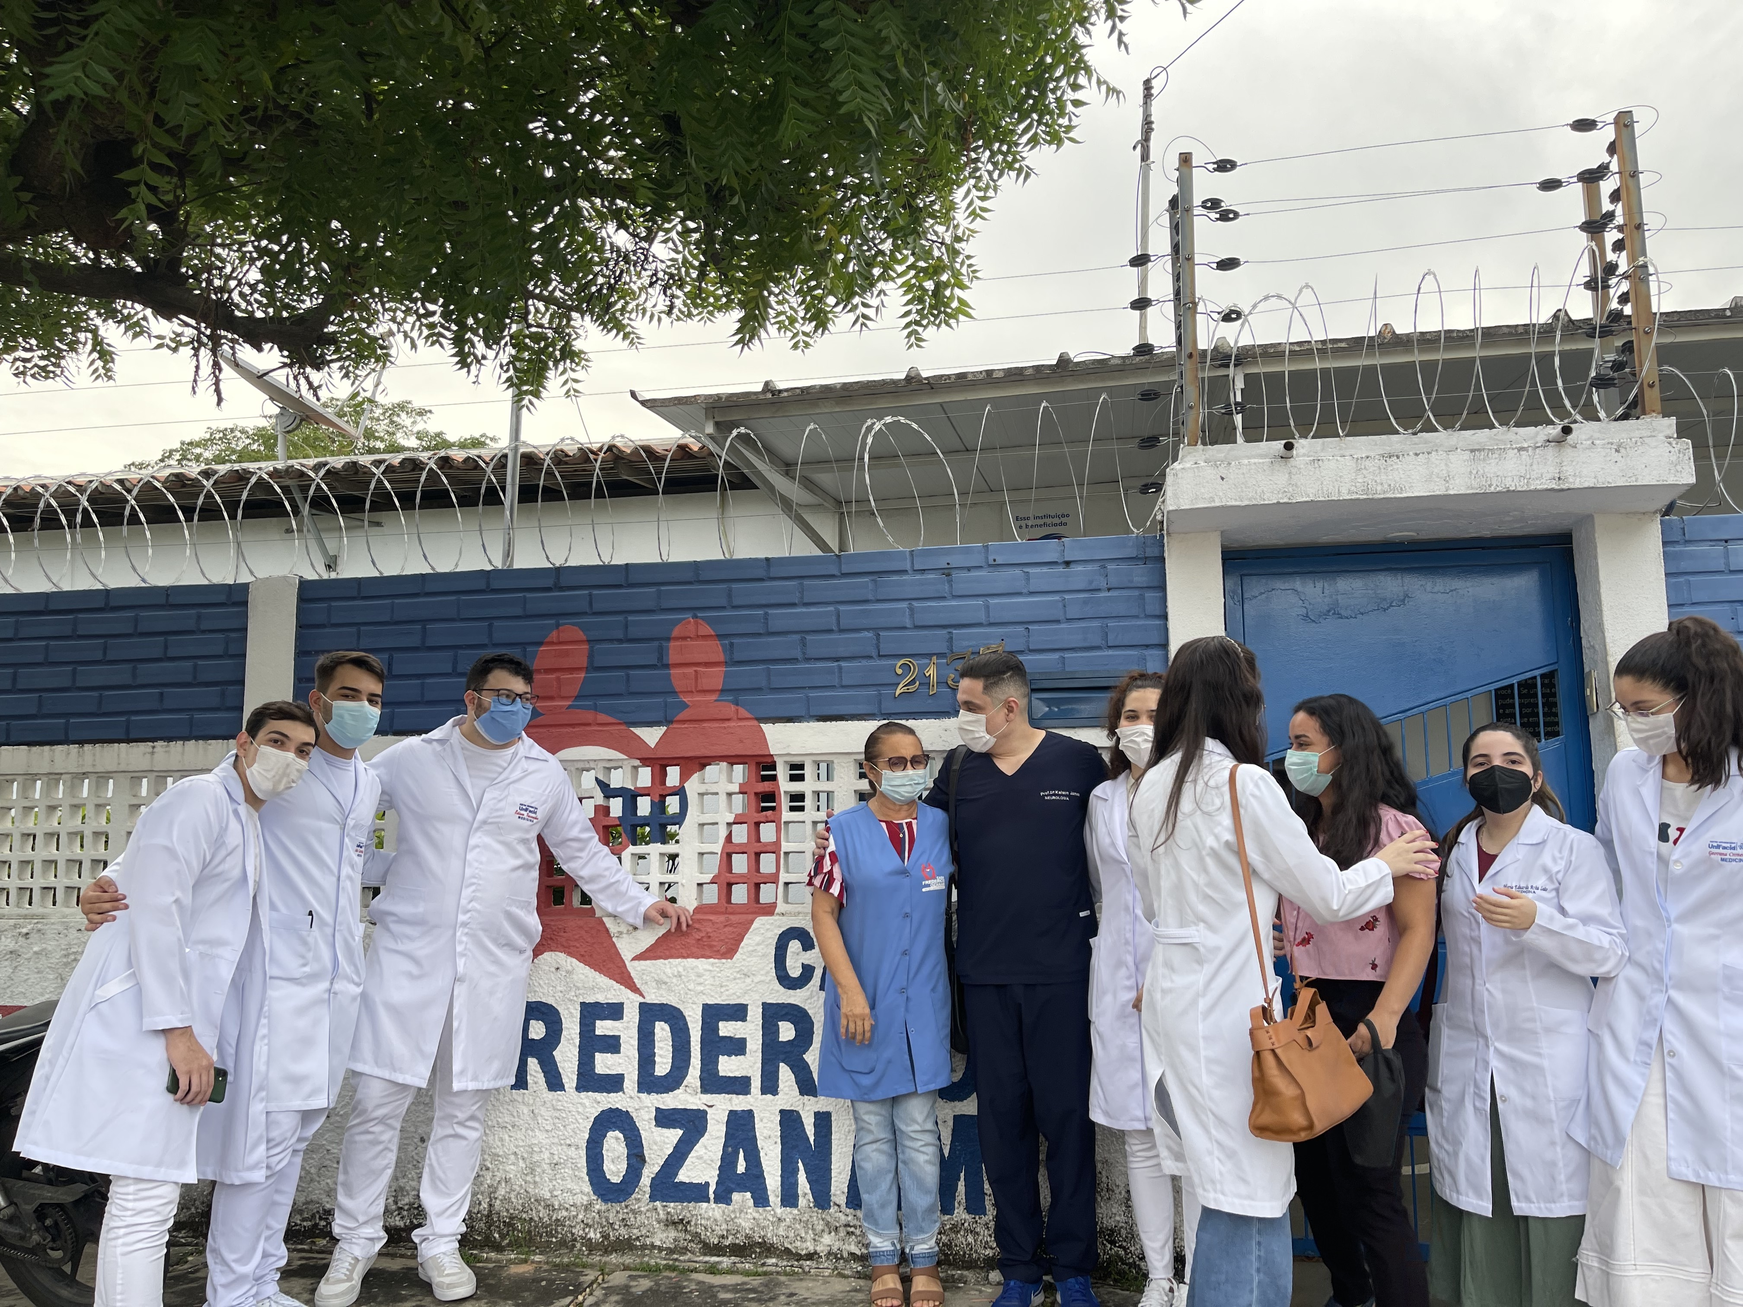
Results
3 Step
Days of care - assisted living home for older adults

Slide 10
Conclusion
We described a university extension project for support in diagnosing Parkinsonism in elderly individuals from communities.
This project allowed:
1) Increasing early diagnosis of Parkinsonism (Parkinsonism in treatment naive individuals was a frequent pattern)
2) Establishing guidelines in rehabilitation
3) Provide long term follow-up by Brazilian Healthy System (SUS)

Slide 11
Community based diagnosis of Parkinsonism as a medical university extension project
Kelson James Almeida (MD, Phd), Lucia Rego Medeiros (MD, Msc), Naldiana Cerqueira (MD, Phd), Marco Aurélio Alves
Thank You!

